Slide 1





AI chatbot using ChatGPT
Team : Name & Email id Guide: P.Raja, Master Trainer
S.Saravanan & saravanan79122004@gmail.com
Disclaimer: The content is curated for educational purposes only.
Notes:
Slides: Prepare a short slide deck (10-12 slides) summarizing the project objectives, methodology, and key results.

Slide 2
OUTLINE
Abstract of the Project
Problem Statement
Proposed Solution
System Architecture
Embedded Video of Project
Conclusion
Future Scope

Slide 3
Abstract
This project presents an intelligent conversational AI chatbot leveraging OpenAI's ChatGPT, a state-of-the-art language model. The chatbot utilizes natural language processing (NLP) and machine learning (ML) to understand and respond to user queries. With its robust architecture, the Chatbot provides human-like interactions, offering information, assistance, and engagement.

Slide 4
Problem Statement
Design and develop an intelligent conversational AI chatbot using OpenAI's ChatGPT that can provide accurate, informative, and engaging responses to users' queries, while addressing the following challenges
Improve user engagement and experience through natural language conversations.
Increase efficiency in providing information and assistance.
Natural Language Processing (NLU) for user input understanding.

Slide 5
Proposed Solution
This proposed solution aims to enhance a ChatGPT-based AI chatbot by improving its contextual understanding, domain expertise, ethical standards, and user privacy. By implementing memory systems, fine-tuning for specific industries, addressing biases, ensuring data security, and supporting multimodal interactions, this solution would significantly enhance the chatbot's capabilities, making it more reliable, personalized, and suitable for a wide range of applications. Continuous learning and transparency would further build user trust, while human-in-the-loop systems provide an extra layer of oversight for critical applications.

Slide 6
System Architecture
Designing the system architecture for an AI chatbot powered by ChatGPT involves multiple components, ranging from front-end interfaces to back-end processing and deployment. Here's a breakdown of the key elements in such an architecture:
User Interface (UI) Layer.
API Gateway / Edge Layer.
Natural Language Understanding (NLU) Layer.
Data Layer.
Security & Compliance Layer.

Slide 7
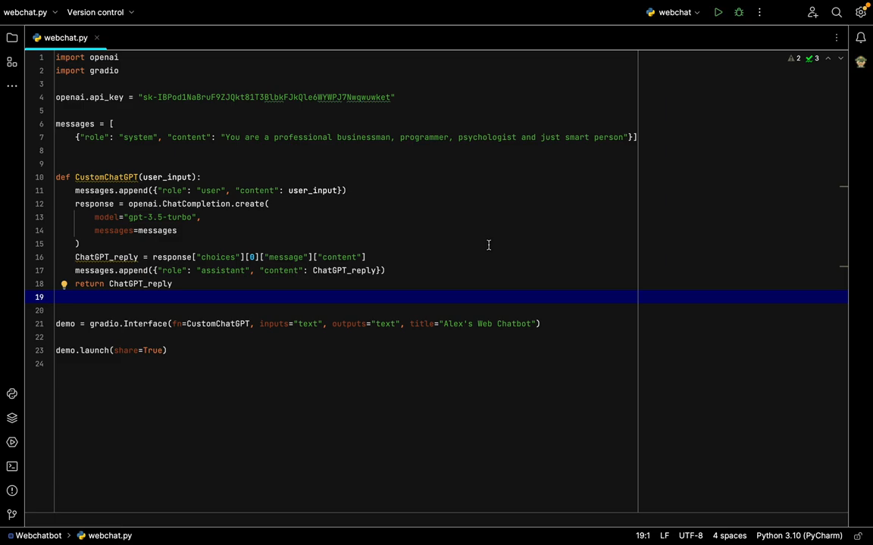
Video of Project Demo

Slide 8
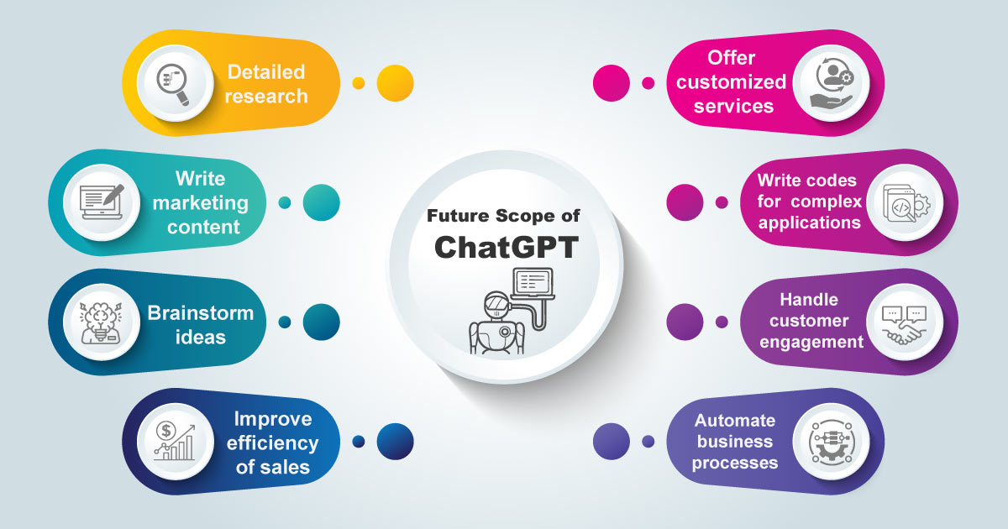
Future Scope

Slide 9
Conclusion
In conclusion, an AI chatbot powered by ChatGPT is a powerful tool that can significantly enhance user interactions across industries, from customer service to education and healthcare. The system's architecture ensures that it is scalable, responsive, and intelligent, offering both the flexibility of advanced natural language processing and the robustness of modern cloud-native technologies. While there are challenges related to safety, privacy, and model limitations, with careful design and ongoing improvements, such a chatbot can provide a seamless, engaging, and effective user experience.

Slide 10
Thank you!
Notes:
thank you very much for joining this PPT, keep learning.
10

